Slide 1
Some Generalised Reductions of Ordered Binary Decision Diagramm
(GroBdd)
Joan Thibault

Slide 2
Boolean Functions
Why ?
  Computer Aided Design (e.g. digital circuit synthesis)
  Knowledge Representation (e.g. Artificial Intelligence)
  Combinatorial Problems (e.g. N-Queens problem)
What ?
  Compact representation
  Operations (e.g. composing, concatening, evaluation)
  Operators (e.g. AND, XOR, ITE, NOT)
  Reductions (e.g. quantification, partial evaluation, SAT)

Slide 3
Boolean Functions
Various representations
  Truth Table
  Conjonctive / Disjonctive Normal Form
  And Inverter Graph
  Binary Decision Diagramm
    Reduced Ordered BDD
    Zero supressed BDD
    Xor based BDD

Slide 4
Section 1
What is a ROBDD ?

Slide 5
Shannon’s Decision Tree
F
= if False
= if True
= False
= True

Slide 6
Bryant’s ROBDD (isomorphic sub-graphs are merged + useless decisions removed)
F
= if False
= if True
= False
= True
0
1
1
2
2
2
2
3
3
For aesthetic reasons, we do not merge all terminals

Slide 7
Bryant’s ROBDD + Complented Edges
(denoted model N (for Negation))
F
= if False
= if True
= False
= True
= Not
0
1
1
2
2
3

Slide 8
Reduced Ordered BDD
=) :
  SAT : constant time
  Any/Max/Min SAT : linear time (#variable)
  #SAT : linear time (#node)
  NOT : constant time
=( :
  AND, XOR : quadratic time/space (#node)
  #node is order dependent
number of

Slide 9
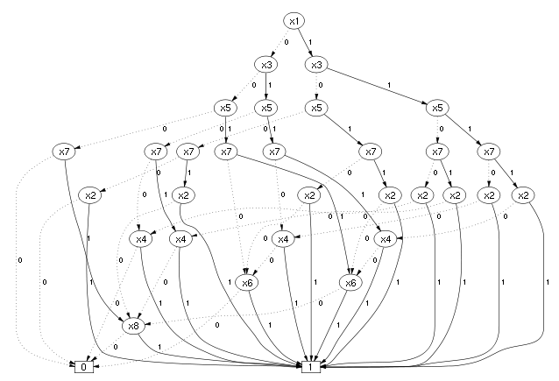
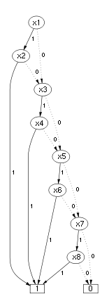
  #node is order dependent

Slide 10
Objective
Reduce #node
Capture information on the edges => less but bigger nodes

Slide 11
Section 2
Compressing a ROBDD into a GroBdd
F
F
SSSS
0
SSS
1
1
SSU
SS
SS
2
2
S
S
3

Slide 12
Section 3
Compiling a formula into a GroBdd
F
SSSS
SSS
SSU
SS
SS
Represents a vector of four elements:
S
S

Slide 13
How to compile a formula into a GroBdd

Slide 14
How to compile a formula into a GroBdd
= if False
= if True
= False
= True
= Not
Step 1: we build
the identity function
S

Slide 15
How to compile a formula into a GroBdd
= if False
= if True
= False
= True
= Not
Step 2: we build one
projection per variable
USUU
UUSU
=
=
3
SUUU
UUUS

Slide 16
How to compile a formula into a GroBdd
= if False
= if True
= False
= True
= Not
F
Virtual nodes
USUU
UUSU
Step 3: we build the
formula
SUUU
UUUS

Slide 17
How to compile a formula into a GroBdd
= if False
= if True
= False
= True
= Not
F
SSSS
USSU
SUUS
Virtual nodes
SU
SU
US
US
Step 4: we factorize
useless variables

Slide 18
How to compile a formula into a GroBdd
= if False
= if True
= False
= True
= Not
F
SSSS
USSU
SUUS
Virtual nodes
SU
SU
US
US
Step 5: we compute
operator nodes

Slide 19
How to compile a formula into a GroBdd
= if False
= if True
= False
= True
= Not
F
SSSS
SUUS
Virtual nodes
USSU
Step 5: we compute
operator nodes
S
S
S
U

Slide 20
How to compile a formula into a GroBdd
= if False
= if True
= False
= True
= Not
F
SSSS
SUUS
Virtual nodes
USSU
Step 5: we compute
operator nodes
S
S
S
U

Slide 21
How to compile a formula into a GroBdd
= if False
= if True
= False
= True
= Not
F
SSSS
SUUS
Virtual nodes
USSU
Step 5: we compute
operator nodes
S
S
S
U

Slide 22
How to compile a formula into a GroBdd
= if False
= if True
= False
= True
= Not
F
SSSS
SSS
Virtual nodes
SSU
SSU
UUS
Step 5: we compute
operator nodes
S
S

Slide 23
How to compile a formula into a GroBdd
= if False
= if True
= False
= True
= Not
F
SSSS
Virtual nodes
SSS
SSU
SS
SS
Step 5: we compute
operator nodes
S
S

Slide 24
How to compile a formula into a GroBdd
= if False
= if True
= False
= True
= Not
F
SSSS
Virtual nodes
SSS
SSU
SS
SS
Step 5: we compute
operator nodes
S
S

Slide 25
Section 4
Results
Average reduction of the number of nodes / estimated memory cost on three benchmarks
 | #node | memory¹
lgsynth91 | -26% | -32%
iscas99 | -25% | -32%
satlib/uf20-91 | -3% | -3%
[1]: memory cost estimated using (a fix 16 bytes ( = 2 x 64 bits pointer ) + a variable length encoding of model’s extra information) per node
lgsynth91:
Downloaded from https://ddd.fit.cvut.cz/prj/Benchmarks/LGSynth91.7z
Compiled from Verilog to Verilog using ABC (https://people.eecs.berkeley.edu/~alanmi/abc/) (DAGaml supports only a subset of Verilog)
Compiled from Verilog to GroBdd using DAGaml (our software : https://github.com/JoanThibault/DAGaml/tree/grobdd-dev)
iscas99 :
Downloaded from http://www.pld.ttu.ee/~maksim/benchmarks/iscas99/vhdl/
Compiled from bench to pla using ABC
Compiled from pla to GroBdd using DAGaml
satlib/uf20-91 (CNF formulas : 20 variables, 91 clauses)
Dowloaded from http://www.cs.ubc.ca/~hoos/SATLIB/Benchmarks/SAT/RND3SAT/uf20-91.tar.gz
Compiled from DIMACS (CNF) to GroBdd using DAGaml

Slide 26
Conclusion
NNI-X
Software implemented in OCaml:
  https://github.com/JoanThibault/DAGaml/tree/grobdd-dev
  ~ 12 000 lines of OCaml
Fewer nodes & Less memory
Future Work
  Quantify the dependency between variables’ order and #node
  Solve & Implement NUA-X and NNI-X versions
TO DO
  Parallelism & hardware acceleration
  Quantification Operators
  Variable Reordering
Other Applications
  Apply similar strategies to compress other DAG
    DAG / Graph isomorphism
    Unification
NNI
NUA-X
NUA
NU-X
NU
N
Z

